Slide 1
Project overview
ScaDS – Competence Center for Scalable Data Services and Solutions Dresden/Leipzig
Dr. René Jäkel

Slide 2
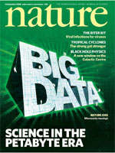
Competence center for big data
4 September 2008
Why is Big Data a phenomenon?
In recent years observation in science from scarce data to data deluge
Big advancement in cheap and easy to use technologies for data taking and computation
Web 2.0
Internet of Things
Industry 4.0
Computing (HPC, Grids/Clouds)
11 February 2011
Notes:
In recent years, technological advancement in easy to use computing systems, growing possibilities to acquire data

Slide 3
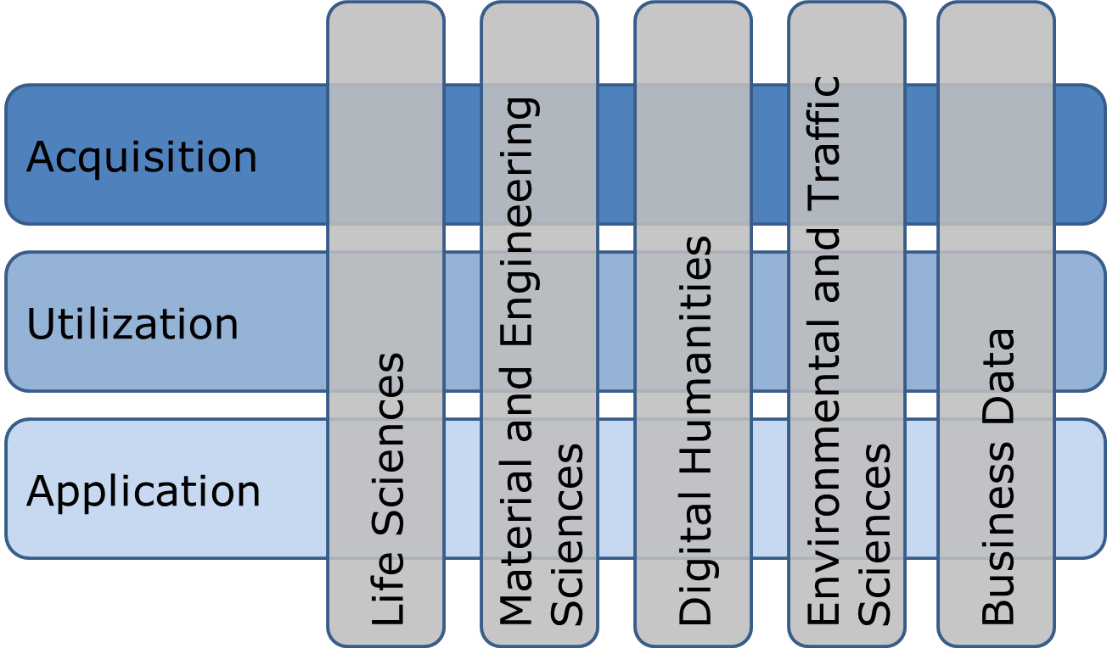
Application sciences
Leipzig
Dresden
Broad range of application sciences in project
Support in data handling over full data life cycle, from creation to results
Transfer of relevant tools in other domains

Slide 4
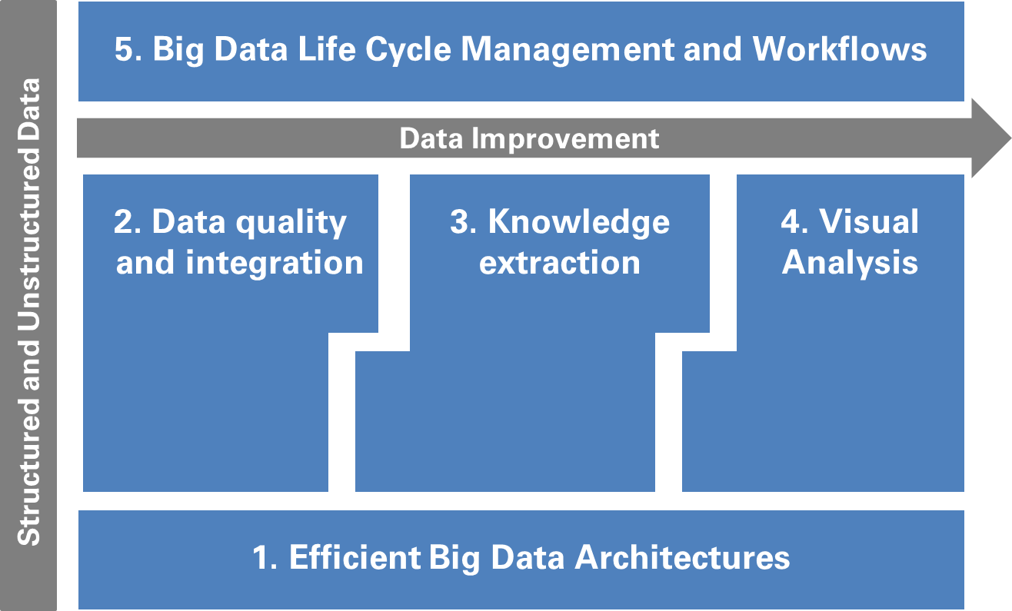
Computer sciences Research
Big Data topics in computer science
Cross-cutting topics to support data/content and its handling
Notes:
Not just collecting challenges, but also means to solve those -> bundling expertice computer science research

Slide 5
Partners
Technische Universität Dresden (TUD)
Universität Leipzig (UL)
Max Planck Institute of Molecular Cell Biology
and Genetics (MPI-CBG)
Leibniz Institute of Ecological Urban and
Regional Development (IÖR)

Slide 6
Associated Partners
Avantgarde-Labs GmbH
Data Virtuality GmbH
E-Commerce Genossenschaft e. G.
European Centre for Emerging Materials and Processes Dresden
Fraunhofer-Institut für Verkehrs- und Infrastruktursysteme (IVI)
Fraunhofer-Institut für Werkstoff- und Strahltechnik (IWS)
GISA GmbH
Helmholtz-Zentrum Dresden – Rossendorf
Hochschule für Telekommunikation Leipzig
Institut für Angewandte
Informatik e. V.
Landesamt für Umwelt, Landwirtschaft und Geologie
Netzwerk Logistik Leipzig-Halle e. V.
Sächsische Landesbibliothek – Staats- und Universitätsbibliothek Dresden
Scionics Computer Innovation GmbH
Technische Universität Chemnitz
Universitätsklinikum Carl Gustav Carus
Individual talks about research topics: applications and methods

Slide 7
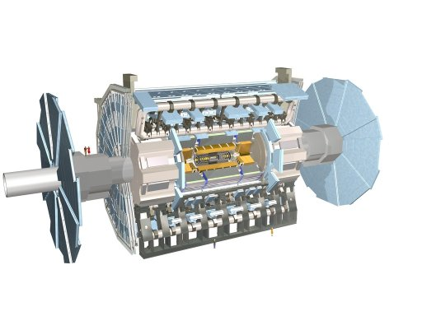
Broad range of Big data topics
More research groups involved
Further application domains and methodic topics
Political Sciences
Analysis of large text corpora
Networking with non-university parties (e.g. Staatliche Kunstsammlungen Dresden, Deutsches Hygienemuseum, etc.)
Particle Physics
Privacy and IT Security
Long-running and large-scale simulations
Mid-term and long-term storage of ATLAS data
Distributed storage and access control
Data-security preserving data monitoring
(semi)automatic Big Data techniques (mining/machine learning)
Notes:
Beside Partners in Project: many more involved groups in ScaDS
Political sciences: Prof. Vorländer (Politikwissenschaft: Politische Theorie und Ideengeschichte)
Privacy: communication patterns have changed, data available for studies, how to combine different data sets and storage

Slide 8
Involved Persons
Universität Leipzig
Prof. Dr. Matthias Blüher Universitätsklinikum Leipzig
Prof. Dr. Martin Bogdan Institut für Informatik Abt. Technische Informatik
Prof. Dr. Gregory Ralph Crane Institut für Informatik, Abt. Automatische Sprachverarbeitung
Prof. Dr. Klaus-Peter Fähnrich Institut für Informatik, Abt. Betriebliche Informationssysteme Universitätsrechenzentrum
Prof. Dr. Bogdan Franczyk Institut für Wirtschaftsinformatik
Prof. Dr. Gerhard Heyer Institut für Informatik, Abt. Automatische Sprachverarbeitung
Prof. Dr. Markus Löffler Institut für Medizinische Informatik Statistik und Epidemiologie
Prof. Dr. Erhard Rahm Institut für Informatik, Abt. Datenbanken
Prof. Dr. Gerik Scheuermann Institut für Informatik Abt. Bild- und Signalverarbeitung
Prof. Dr. Peter Stadler Interdisziplinäres Zentrum für Bioinformatik
Prof. Dr. Michael Sturmvoll Universitätsklinikum Leipzig
Max-Planck-Institut für Zellbiologie und Genetik (MPI-CBG)
Prof. Dr. Eugene Myers
Prof .Dr. Ivo Sbalzarini
Prof. Dr. Marino Zerial
Leibniz-Institut für ökologische Raumentwicklung (IÖR)
Dr. Tobias Krüger
Dr. Gotthard Meinel
Dr. Marco Neubert
Prof. Dr. Jochen Schanze
Dr. Rico Vogel
Technische Universität Dresden
Prof. Dr. Christian Bernhofer Institut für Hydrologie und Meteorologie
Prof. Dr. Raimund Dachselt Institut für Software- und Multimediatechnik
Dr. Andreas Dahl Biotechnologisches Zentrum
Prof. Dr. Jochen Fröhlich Institut für Strömungsmechanik
Dr. Bernd Grüber Institut für Leichtbau und Kunststofftechnik
Prof. Dr.-Ing. habil. Maik Gude Institut für Leichtbau und Kunststofftechnik
Prof. Dr. Stefan Gumhold Institut für Software- und Multimediatechnik
Prof. Dr. Michael Kobel Institut für Kern- und Teilchenphysik
Prof. Dr. Thomas Köhler Medienzentrum, Institut für Berufspädagogik und Berufliche Didaktik
Prof. Dr. Wolfgang Lehner Institut für Systemarchitektur, Datenbanken
Prof. Dr. Wolfgang E. Nagel Zentrum für Informationsdienste und Hochleistungsrechnen (ZIH), Institut für Technische Informatik
Dr. Ralph Müller-Pfefferkorn Zentrum für Informationsdienste und Hochleistungsrechnen
Prof. Dr. Ingo Röder Institut für Medizinische Informatik und Biometrie
Prof. Dr. Carsten Rother Computer Vision Lab
Prof. Dr. Joachim Scharloth Institut für Germanistik
Prof. Dr. Michael Schroeder Biotechnologisches Zentrum der TU Dresden
Prof. Dr. Ralph Stelzer Institut für Maschinenelemente und Maschinenkonstruktion
Prof. Dr. Thorsten Strufe Institut für Systemarchitektur Datenschutz und Datensicherheit
Prof. Dr. Elly Tanaka Zentrum für regenerative Therapien (CRTD)
Prof. Dr. Hans Vorländer Institut für Politikwissenschaft
Commitment to participate and contribute and profit from ScaDS solutions and developments

Slide 9
How to deal with Big data?
Big
Data
„Application driven
approach“
„Data scientists approach“
Test of hyposisis
Modify/develop model
Acquire more data to test/falsify model
Specific sources (simulations, sensors, etc)
Different perspective,
but:
Methods in focus
Use/develop tools
Content oriented, expand data basis
Support broad range of applications
Teach scientist how to extend given models or bring the data scientists to the content of data?
Notes:
Often different perspective: teach the scientist how to use sophisticated tools or enable the data scientist to understand the content of domain specific data?

Slide 10
Basic goals
Bundling and expansion of existing expertise
Close interdisciplinary interconnection and cooperation of computer science and application research experts
Building an institutionalized network structure
Knowledge exchange and transfer
Teaching: Enhance academic courses with Big Data methods and solutions
Drive Big Data innovations
Support excellent and innovative Big Data research
Clear focus on science and business applications within the project
Thematically open to other state-of-the-art research
Notes:
Support this actions: identified basic goals

Slide 11
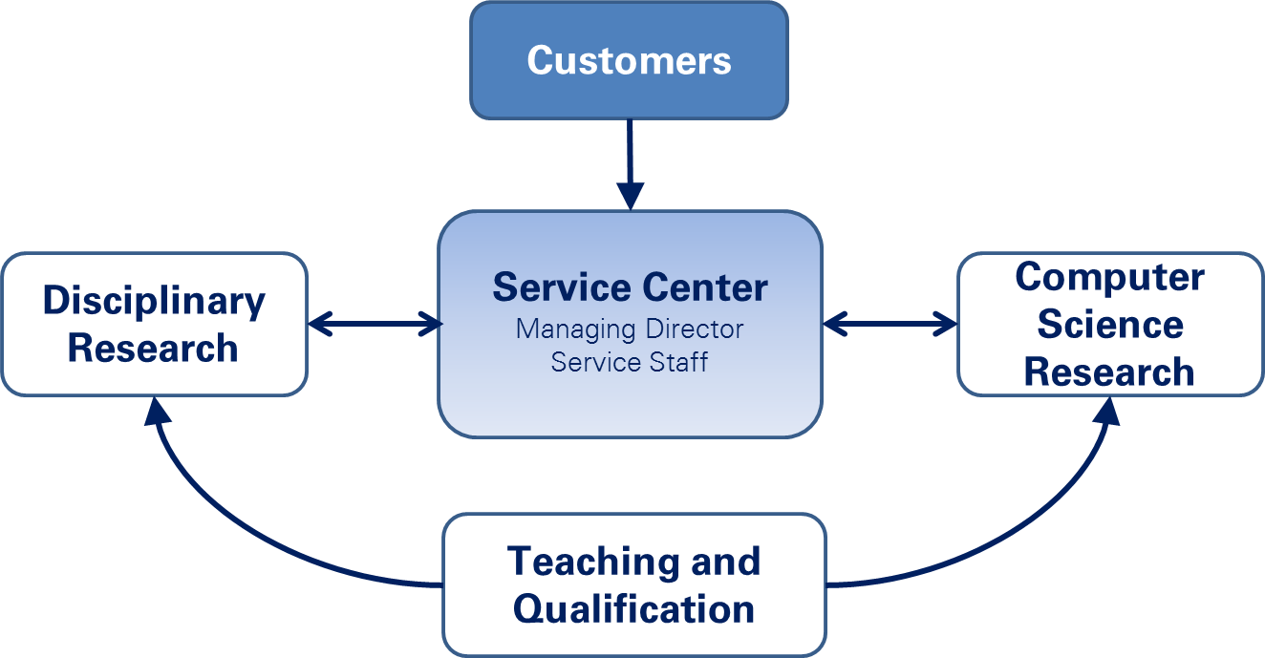
SCadS Dresden/Leipzig – Service center
Working environment for focused research
„science oriented approach“
„Data scientist approach“
Notes:
Realize defined goals: support via service center

Slide 12
Service Center – Structure
Bring together application domain scientist and specialist from computer sciences
Supported by Service Center in research
Application scientists
Service Center
Computer Scientists
+
+

Slide 13
Big Data Services and Solutions
Service Center: Support and research topics
Central contact point for addressing current and future Big Data challenges
Service Center as a "Single Point of Contact"
Modular and service-oriented approach
Research topics aligned with the needs of the users
Set up cross-disciplinary service portfolio
Problem oriented concepts and solutions
Support and operation (prototypes)
Holistic approach aligned with the international state-of-the-art research (exchange of information with other projects)
Notes:
Collaborative efforts always difficult, -> how to solve the ‚question‘: teach data analysts or scientist?

Slide 14
Governance Structure
Wissenschaftlicher Beirat
Erweiterter Vorstand
Vorstand
Wissenschaftlicher Koordinator
Stellv. Wissenschaftlicher Koordinator
Anwendervertreter
Themenbereichs-
koordinatoren
Koordinatoren der Anwendungs-
bereiche
Geschäftsführer
Notes:
Competence center steered by Executive board: Vorstand
Extended executive board: Erweiterter Vorstand:
Management director: Geschäftsführer
Supported by Scientific board: wissenschaftlicher Beirat

Slide 15
Guest Program
Invite experts to collaborate
Strategic element to widen Big Data spectrum to support broad range of topics
Different periods for guest visits
Short – several days
Medium – weeks
Long – 1-3 months
Competitive approach: proposals approved by executive board
Notes:
Gastprogramm: support broad range of topics, close collaboration with service center and experts

Slide 16
Cooperation and information exchange
Other competence center and projects
Berlin Big Data Center (BBDC)
Competence centers for IT Security
Projects form Smart Data and Big Data initiatives,
future projects
LSDMA – Large Scale Data Management and Analysis
Notes:
Gastprogramm: fill thematically gaps to support broad range of topics, close collaboration with service center and experts

Slide 17
Meeting structure
Various ways of interaction for partners and guests
All-Hands Meetings: organized by BMBF, BBDC, ScaDS
Big Data Workshops: organized in collaboration with BBDC
Summer school for Big Data
Project meetings, 4/year
Working groups and user meetings
Annual User Forum
ScaDS: Platform for information exchange
Different mailing lists
System to share content and source code
Notes:
Summer school: one week from 2015 on

Slide 19
Acquisition
Utilization
Material and Engineering Sciences
Business Data
Life Sciences
Environmental and Traffic Sciences
Digital Humanities
Application

